Slide 1
Automatic recognition steel microstructure for high throughput quality control system
Project Type: Deep Learning

Slide 2
Team Mates
01
02
03
Dr Subhas Ganguly
21f1000265
Gaali Gaurav Krishna
21f2000631
Dinesh Kumar Kumawat
21f1001956

Slide 3
The microstructure recognition problem

Slide 4
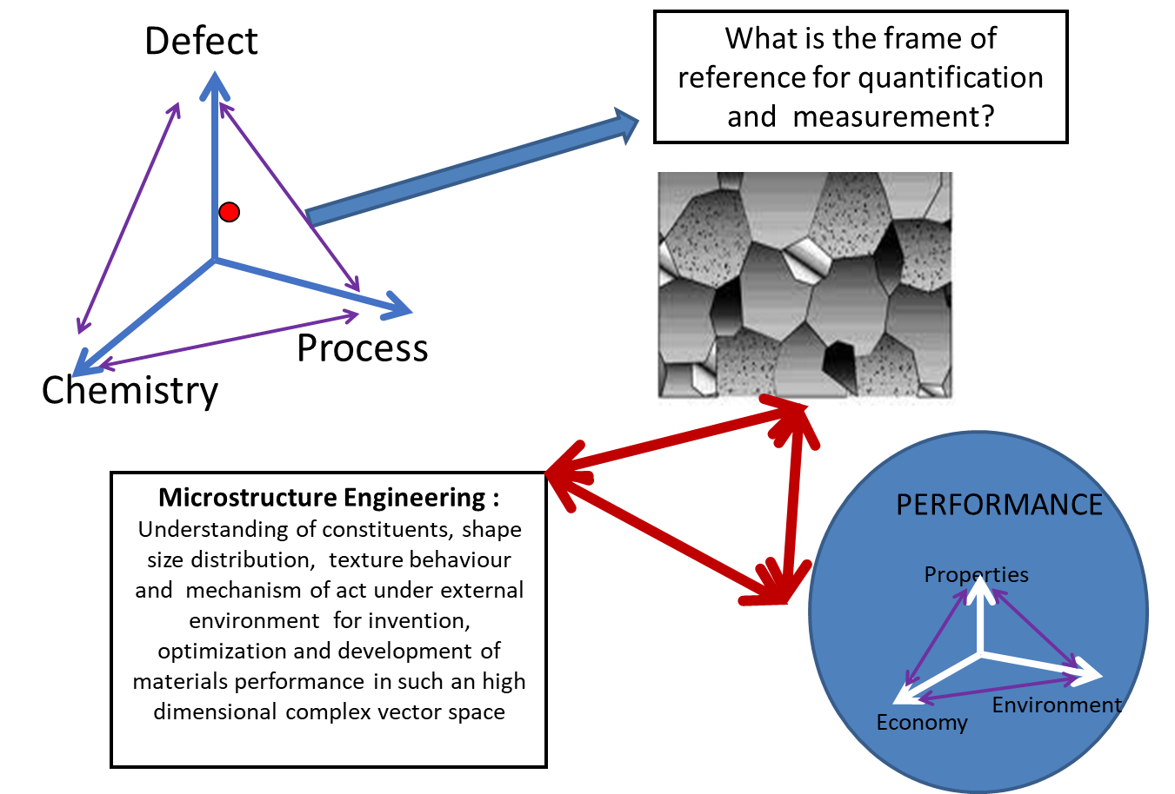

Slide 5
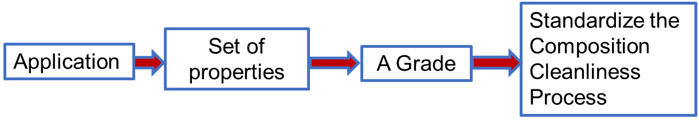
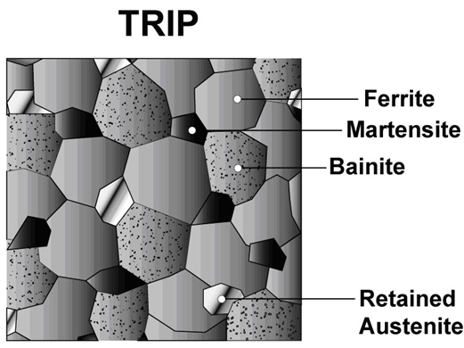
Role of microstructure in steel design
Phase identification human expertise based
How to digitialize this task??

Slide 6
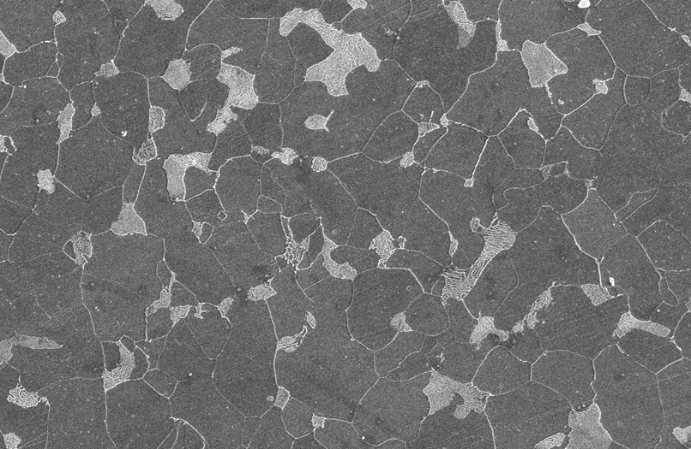
A typical real microstructure image

Slide 7
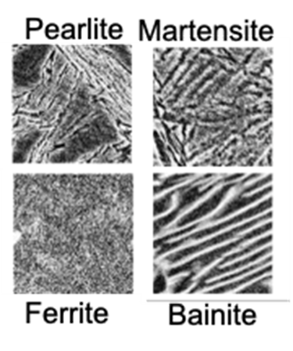
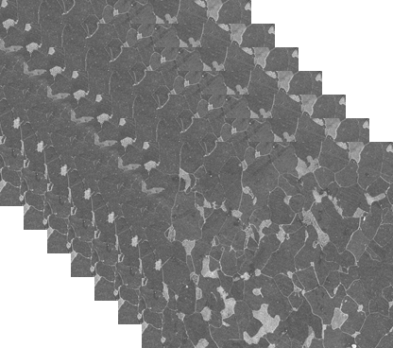
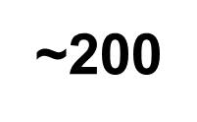
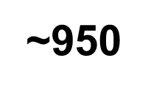
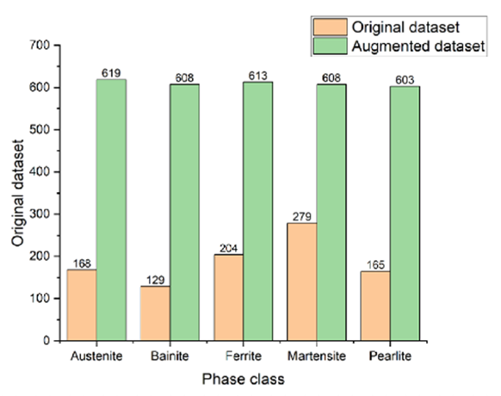
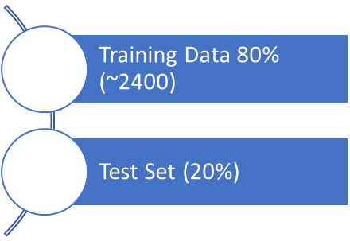
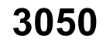
Data
Collated and in house generated data
Augmented Data
Segmentation and Patch extraction with label

Slide 8
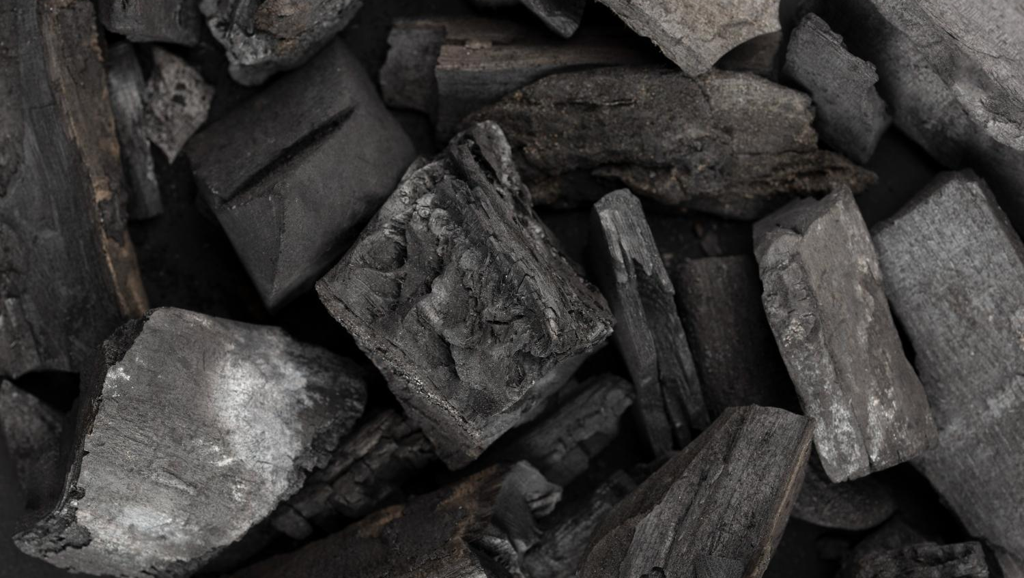
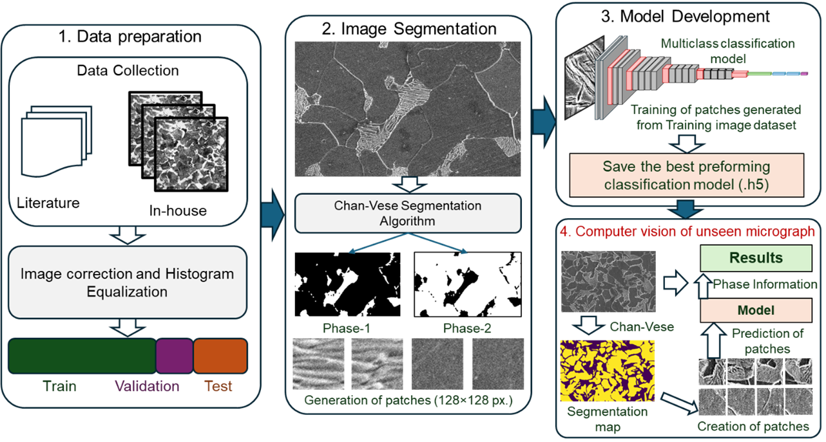
A deep learning framework toward high throughput analysis of steel microstructure
Schematic representation of image segmentation and classification model framework for digital recognition of phase constituents

Slide 9
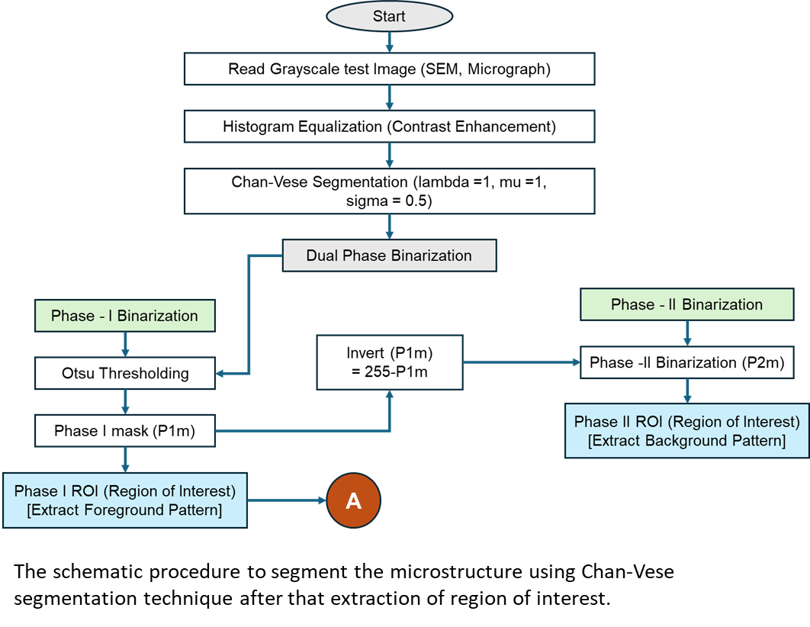
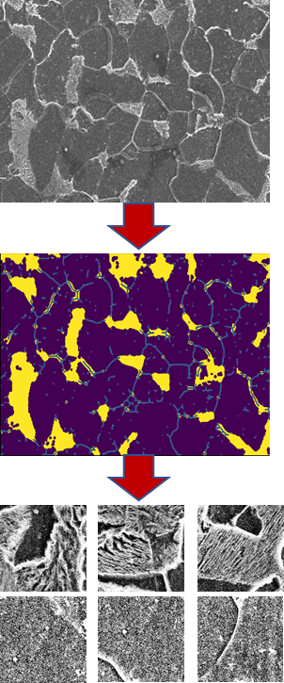
Segmentation using Chan-Vese technique for patch creation

Slide 10
Model Evolution
Component | Choice / Setting
Loss | Binary Cross Entropy
Metrics | Accuracy, Precision, Recall, F1
Optimizers | AdamW and SGD (momentum 0.9)
Learning Rates | 1e-5, 3e-5, 1e-4, 3e-4
Weight Decay | 0, 1e-5, 1e-4, 1e-3
Dropout | 0.0, 0.3, 0.5
Batch Sizes | 8, 16, 32
Schedulers | None / Cosine Annealing LR
Epochs | 10, 20, 30
Hardware | GPU (Colab T4 / A100)

Slide 11
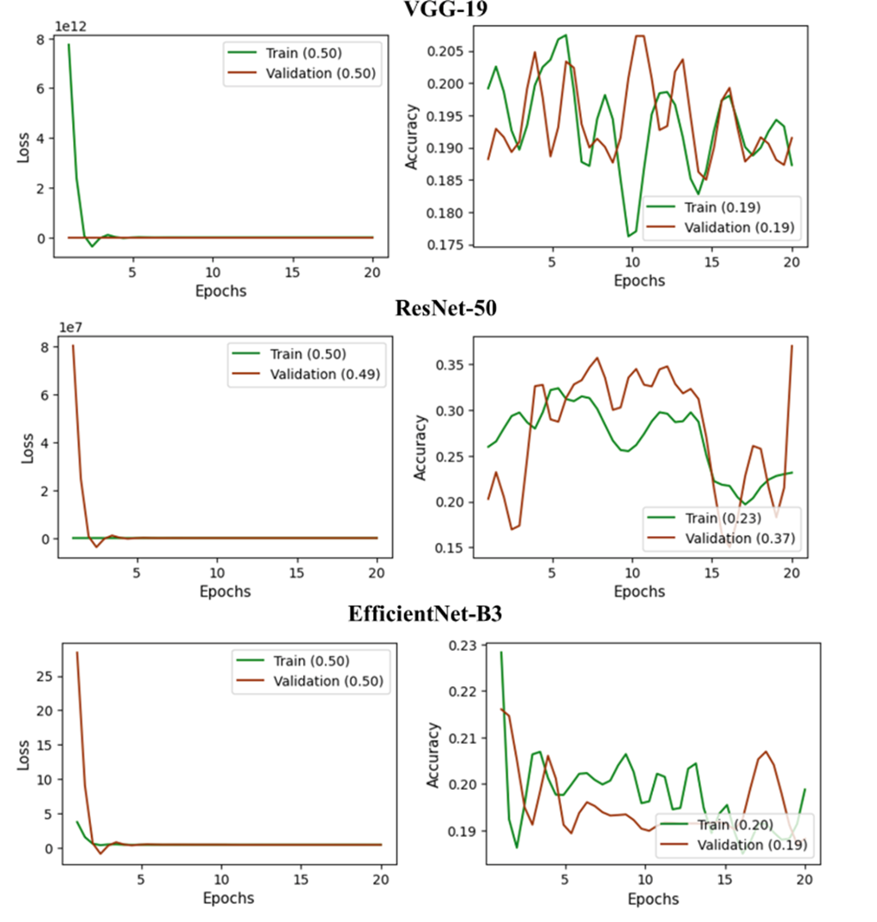
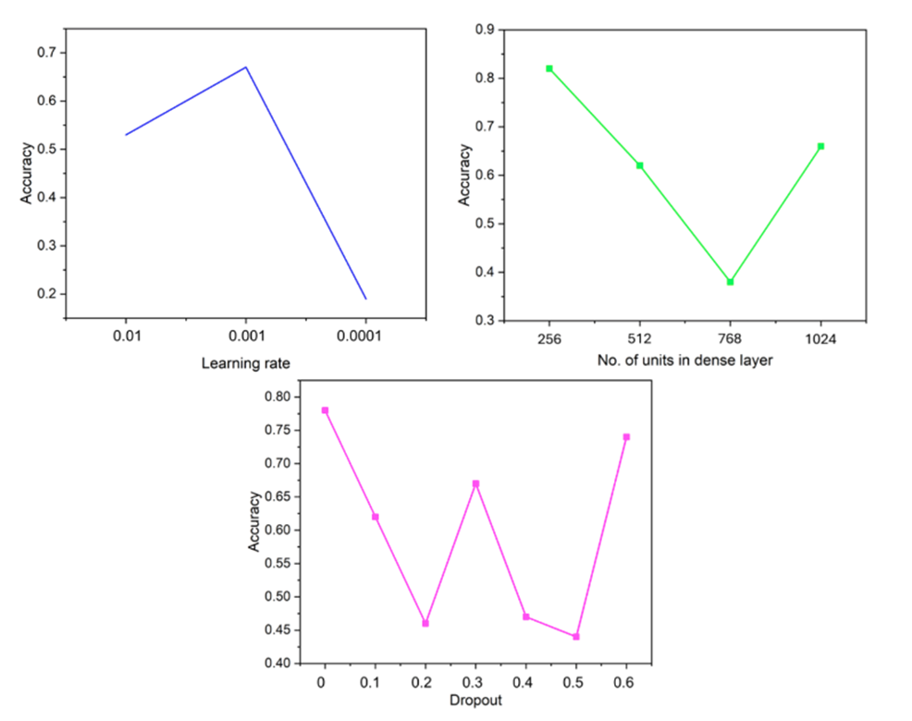
Comparison b/w models

Slide 12
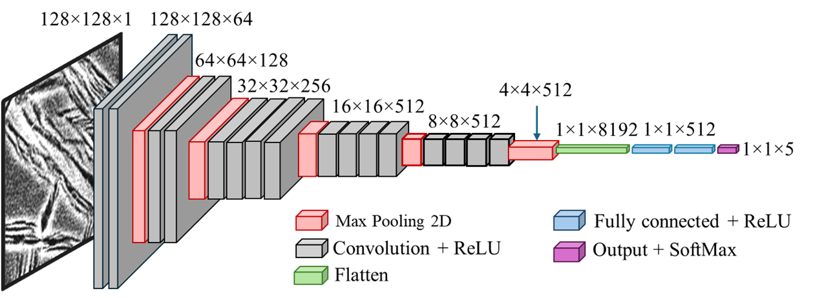
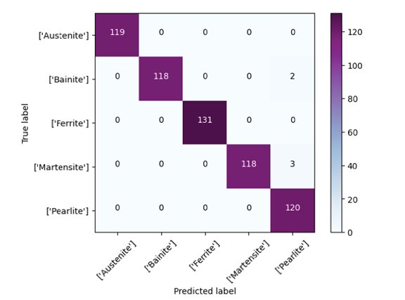
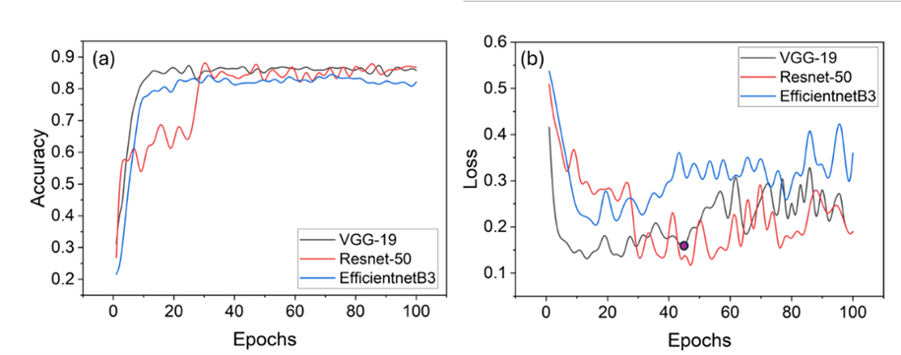
Classification Model

Slide 13
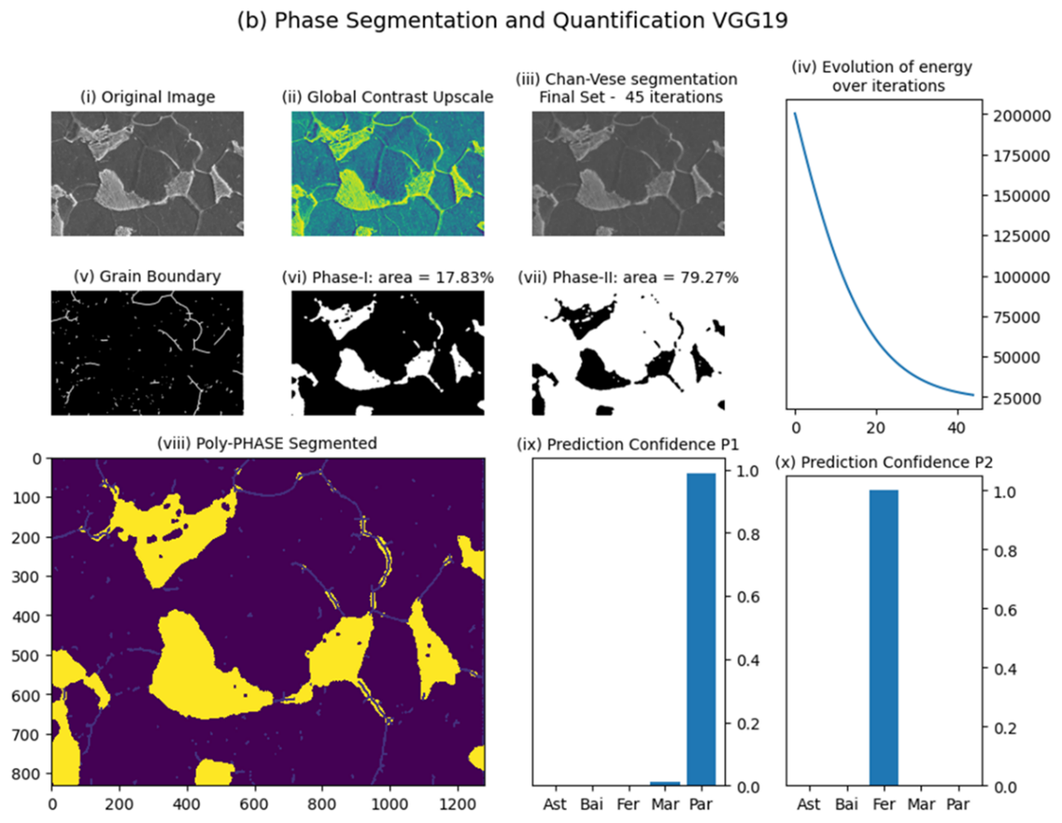
Some results

Slide 14
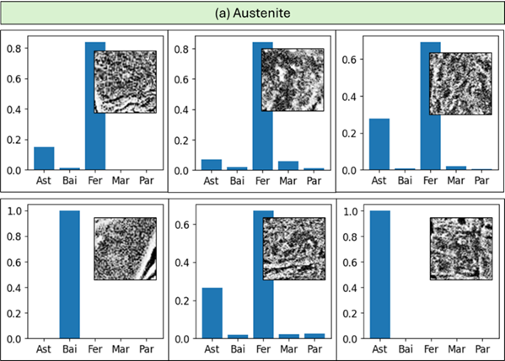
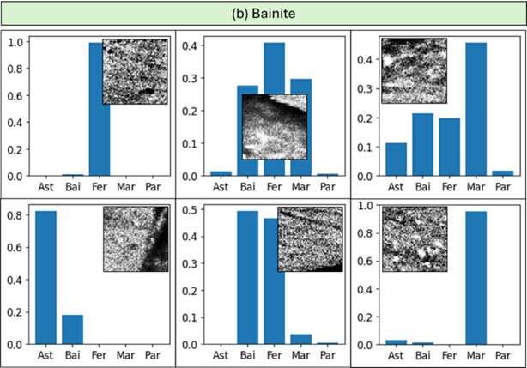
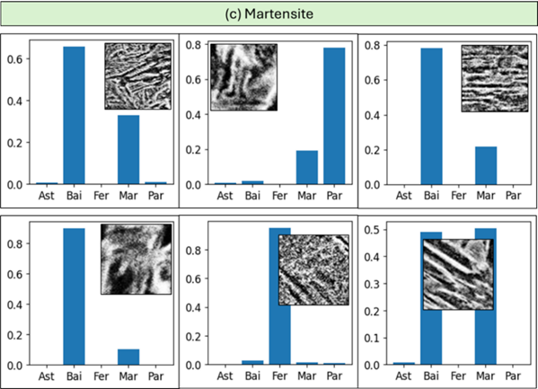
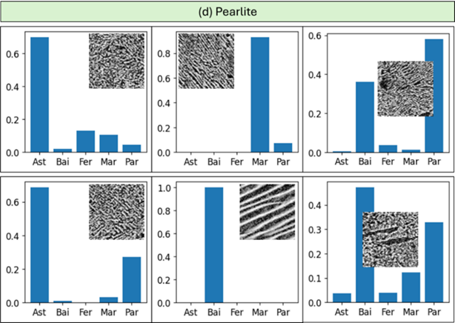
Confusion between phase

Slide 15
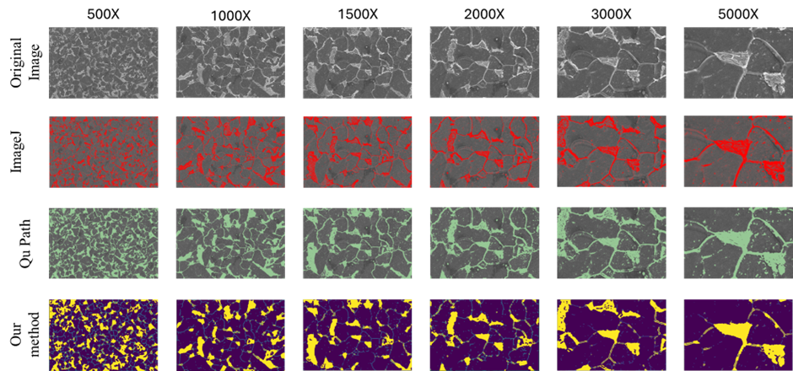
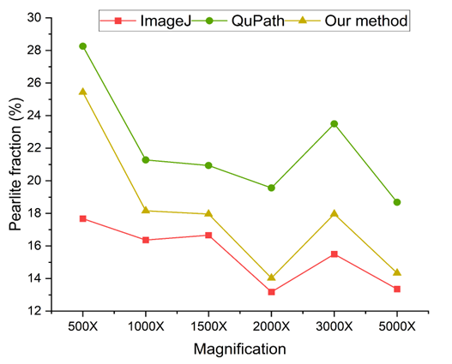
Some Results
Segmentation results. From left to right magnification increases from 500× to 5000×.
Comparison of the pearlite phase fraction obtained from ImageJ, QuPath, and the proposed model with the increase of magnification.

Slide 16
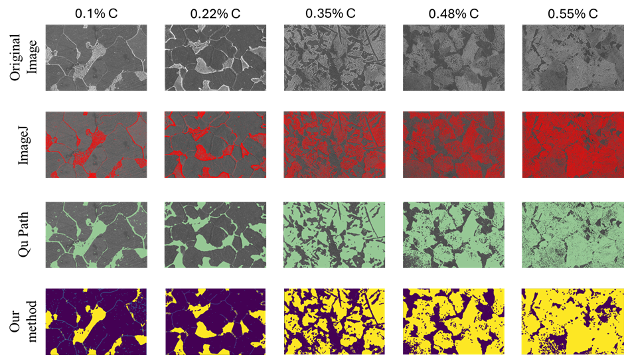
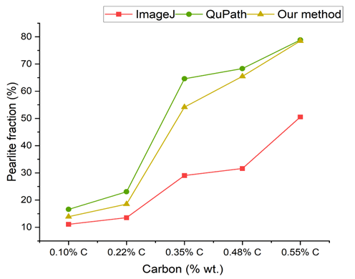
Some Results
Segmentation results, From left to right, the carbon percentage increases from 0.1% C to 55% C.
Comparison of the pearlite phase fraction obtained from ImageJ, QuPath, and the proposed model with the increase of C (wt.%).

Slide 17
Limitations and Future Scope
Misclassification among martensite, bainite, and pearlite, which is mainly consistent with their overlapping morphological features.
A hierarchical classification framework could first separate phases into broader categories (e.g., equiaxed versus lamellar/lath-like microstructures), followed by a specialized classifier to distinguish closely related phases such as bainite, martensite, and pearlite. Finally, ensemble approaches that combine deep CNN features with handcrafted texture descriptors could provide complementary perspectives and reduce phase-specific biases.
Although these approaches are beyond the scope of the current work, they present promising avenues for future studies aimed at improving phase-level discrimination.
In contrast, segmentation and classification task can be performed simultaneously by the models like YOLO and U-Net algorithms, however, pixel level ground truth will be required to train these models.

Slide 18
Thanks!
Do you have any questions?
Group 11

